Slide 1


Nature credit challenges around the world; Finland in context
Dr Sophus zu Ermgassen, University of Oxford
Senior Research Fellow, Nature finance lead | Nature-positive Hub | Leverhulme Centre for Nature Recovery | Oxford EARTH

Slide 2
Caveats / excuses
Very little experience in Finnish environmental policy context
Have not seen day-to-day workings of system
Many brilliant people have been working on this and everything that is done has been chosen for a reason; take their word over mine
Have studied offset systems around the world and looking for common patterns across biodiversity measurement, governance and financing

Slide 3

Evaluation complementary to Kujala et al.

Slide 4
Nature markets around the world
 | Who buys them? | Who sells them? | How’s it measured? | How does it deal with additionality? | Who checks everything is going to plan?
US wetland mitigation | Developers | Mitigation banks* | Area of wetland and performance standards | Implicit | US Army corps of engineers
Victorian native vegetation | Land clearers | Landholders; brokers | Habitat hectares plus projections of change | Implicit | State government
International voluntary avoided deforestation | Companies | Project proponents; brokers | Varies | Varies | Voluntary non-state governance
International voluntary biodiversity | Nobody yet | Project proponents; brokers | Varies | Varies | Voluntary non-state governance
England BNG | Developers | Developer-led, Habitat banks | Statutory biodiversity metric | Implicit | Local authority; responsible bodies
Finland | ? | Landholders; habitat banks | Nature value hectare | Implicit | National government

Slide 5
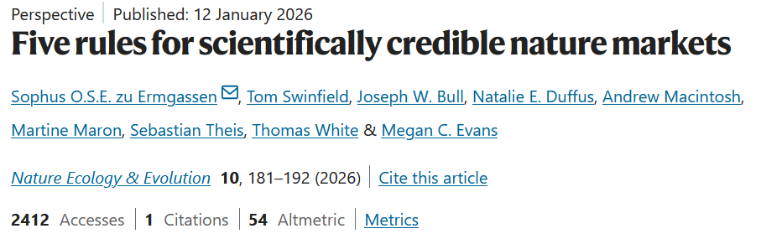

Slide 6
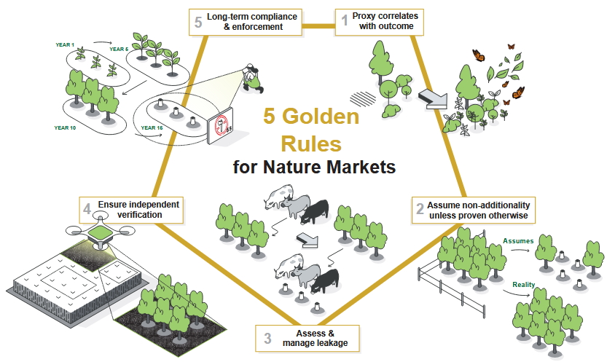
Five rules for scientifically-credible nature markets
zu Ermgassen et al. (2026), Nature Eco Evo

Slide 7
How we measure biodiversity
zu Ermgassen et al. (2026), Nature Eco Evo

Slide 8
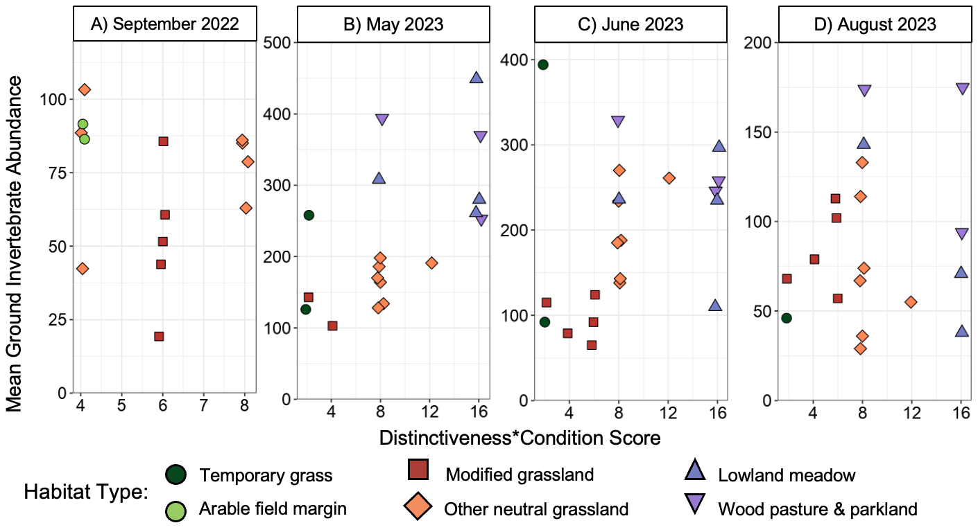
England’s case study – habitat hectares-type
Duffus et al. (2025), J Applied Ecology

Slide 9
Finland’s approach
Ex-ante projections based on a baseline habitat assessment & extraordinarily intensively co-created biodiversity response functions
Our best possible estimate of biodiversity responses to different conservation interventions
The most robust ex-ante system I have seen
The amount of legitimacy built through the extensive engagement will be invaluable
But the big risk with ex-ante systems… what if our science was wrong?

Slide 10
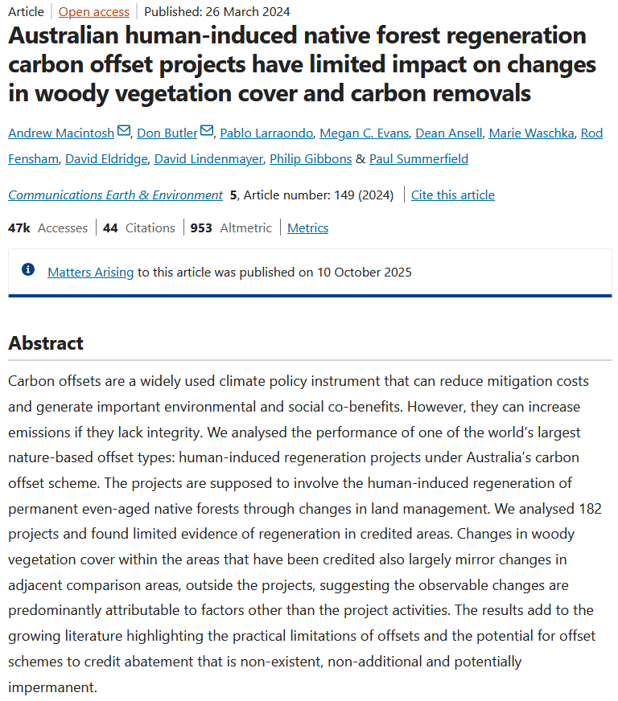
Example of problematic ex-ante system

Slide 11
Implications for Finland
Some monitoring required to validate ex-ante projections
Without monitoring the system faces a major legitimacy risk
Investment follows legitimacy (example of VCM)
The biggest problem with offset systems is not ecological measurement, it’s non-compliance (see later)

Slide 12
Additionality
zu Ermgassen et al. (2026), Nature Eco Evo

Slide 13
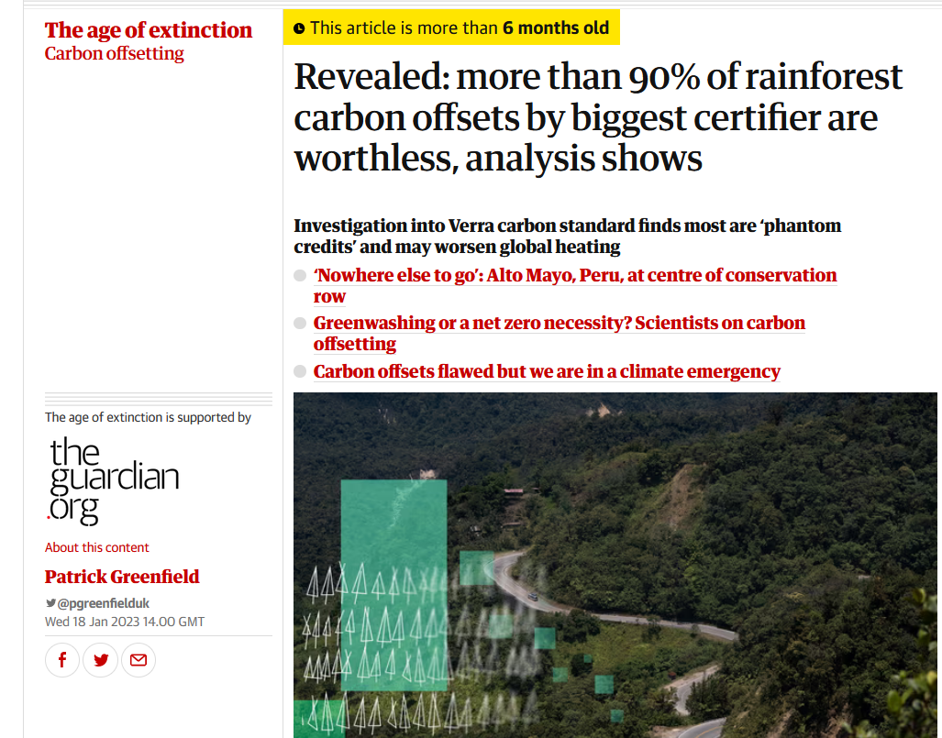
Additionality

Slide 14
Why is additionality so important?
When you’re buying the compensation of a loss, it’s really important that thing is real or the loss is in reality uncompensated
People opt into nature markets if their opportunity costs are low
So in a market where sellers opt in to selling, you’re selecting for those who would have done that thing anyway
ex-post evaluations have detected widespread non-additionality – except Inkinen et al. 2022 (US wetland mitigation banking) which rewards highly capital-intensive up-front investment

Slide 15
zu Ermgassen et al. 2023, Global Change Biology

Slide 16
No difference between offsets and controls for 47% of sites
Controls outperformed offsets for 22% of sites
Offsets outperformed controls for 30%
For 7, offsets worked well (prevented loss of >10% vegetation)
zu Ermgassen et al. 2023, Global Change Biology

Slide 17
Finland’s approach
Policy additionality, combined with a mostly static baseline and reward for uplift (except maintenance credits)
Somewhat equivalent to the criteria used in Victoria
Does not explicitly test for additionality; this is a risk. This is probably OK if all the conservation measures were capital intensive – but some are not, so it will be hard to tell if some of them would have happened anyway

Slide 18
(Market) Leakage
zu Ermgassen et al. (2026), Nature Eco Evo

Slide 19
Transparency and third-party verification
zu Ermgassen et al. (2026), Nature Eco Evo

Slide 20
Why is third-party verification so important?
Every single nature market ever evaluated has been found to not be achieving its full environmental objectives; and every single evaluation was enabled by public transparency
Systems iteratively improve
Transparency enables ratings agencies, data providers
But transparency is not enough if at least some of the outcome variables from the system cannot be tracked through either standardised project sampling or remote sensing.

Slide 21
Finland’s approach
World-leading approach to transparency in the register
But transparency alone not enough for accountability; some degree of being able to detect compliance via remote sensing necessary, or substantial commitment to field surveying
Propose an audit of the management actions rewarded in the system to see what remote sensing variables could be used to evaluate performance of the system and what % of the overall gains credited in the system can be validated through remote sensing

Slide 22
Long-term compliance and enforcement
zu Ermgassen et al. (2026), Nature Eco Evo

Slide 23
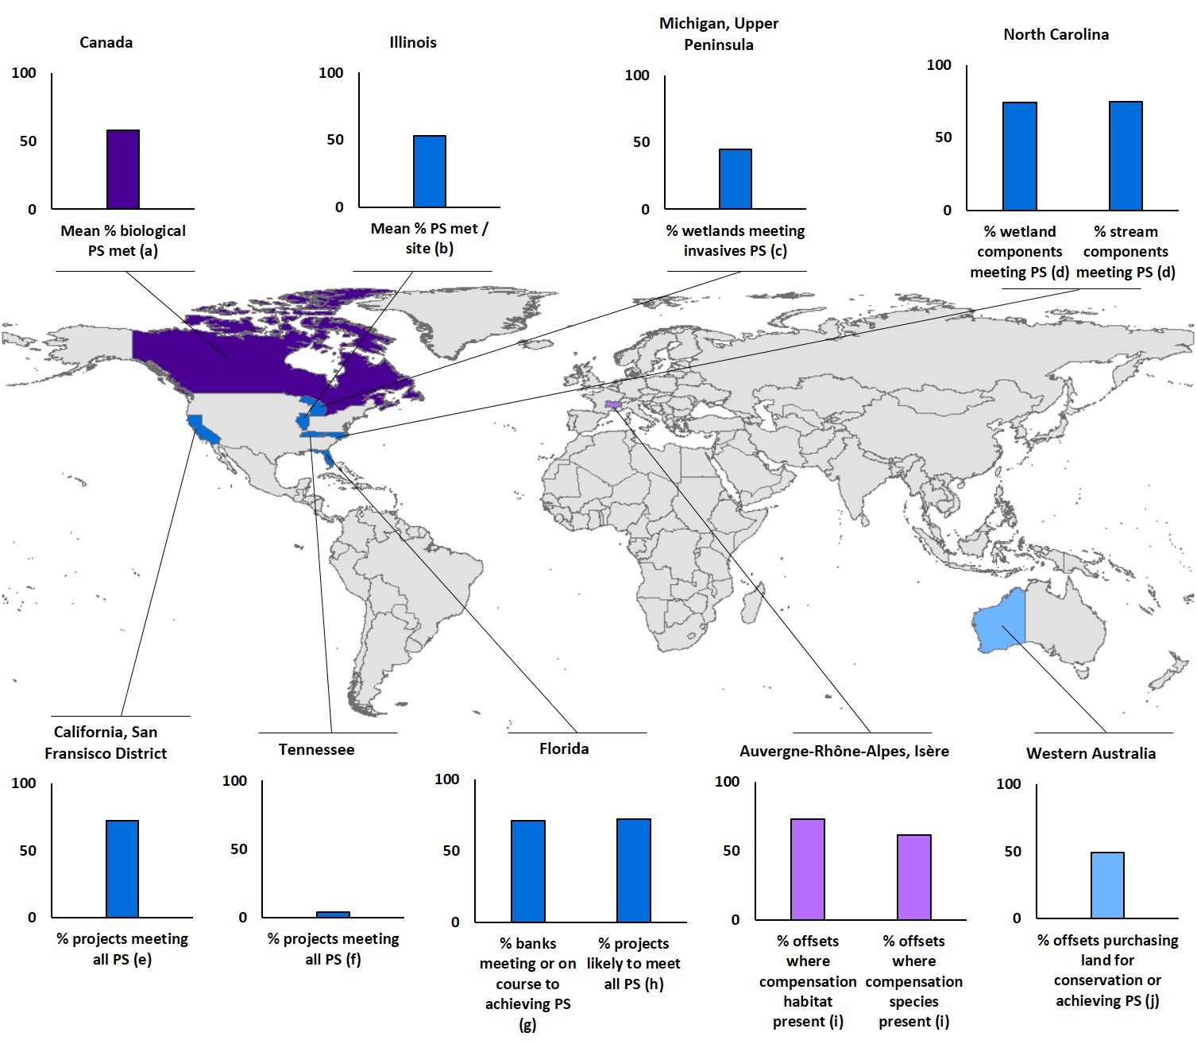
Who checks everything is going according to plan?
zu Ermgassen et al. (2019), Cons Letters

Slide 24
Finland’s approach
Legal permanence is world-leading
Ongoing monitoring very limited, serious risk
Other ex-ante projection-based systems without monitoring have led to major integrity scandals – Human-induced regeneration in Australia

Slide 25
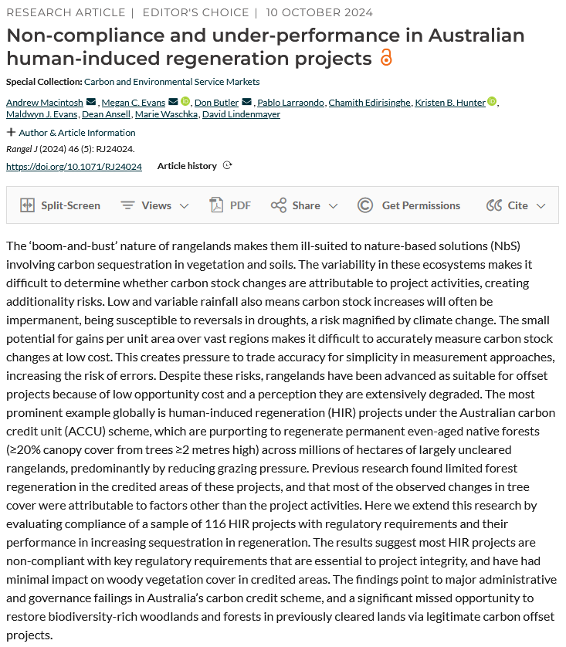

Slide 26
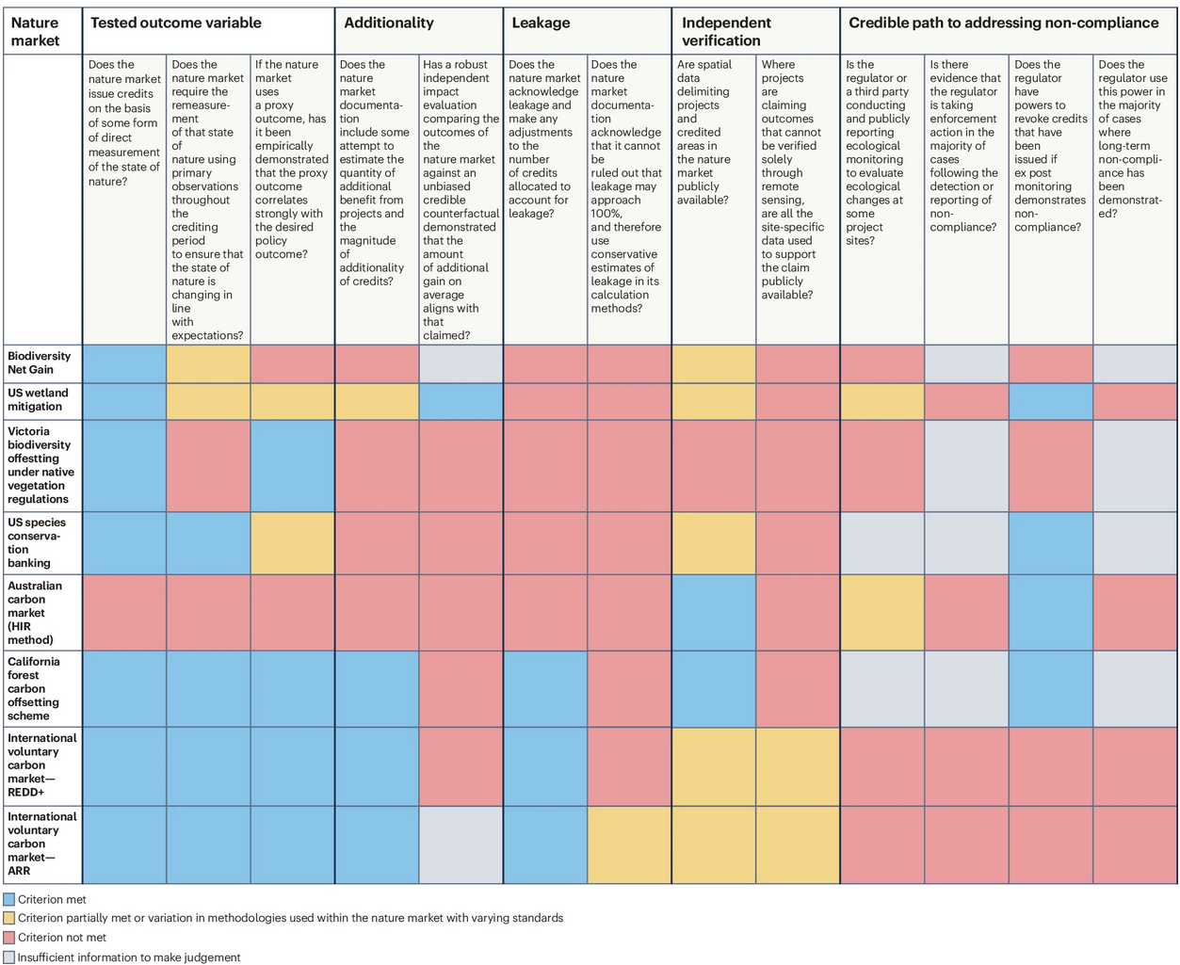
zu Ermgassen et al. (2026), Nature Ecology & Evolution

Slide 27
Key things to avoid
Don’t make (all of the) the outcome variable(s) something you can’t check from space
If you want additionality, don’t give credits for things where you can’t tell if they would have happened anyway (ie things with low up-front costs where distinguishing between additionality and non-additionality is challenging; and it’s hard to check)
Don’t concede robustness to stakeholders that advocate lower barriers to entry at the cost of integrity – it will undermine the ecological outcomes & confidence is everything

Slide 28
Other considerations in Finnish system
Demand drivers. Nearly all the world’s largest nature markets have a regulatory demand driver
  US wetlands - $15 bn per year (BenDor et al. 2023)
  England – compare woodland carbon code (~£7m, 15 years) with Biodiversity Net Gain (~£7m, 1.5 years) (Stuart & zu Ermgassen 2026)
Matching up buyers and sellers. Key consideration; ensure appropriately explored; work of Kangas et al.

Slide 29
Other considerations in Finnish system
Institutional fit between conservation priorities and measurement methods. Finland has major potential conservation gains from forest protection; this offset policy will not do this (uplift-based, prioritising restoration over protection)
  Need to ensure have complementary tools for forest protection targeting conservation priorities not addressed through policy

Slide 30
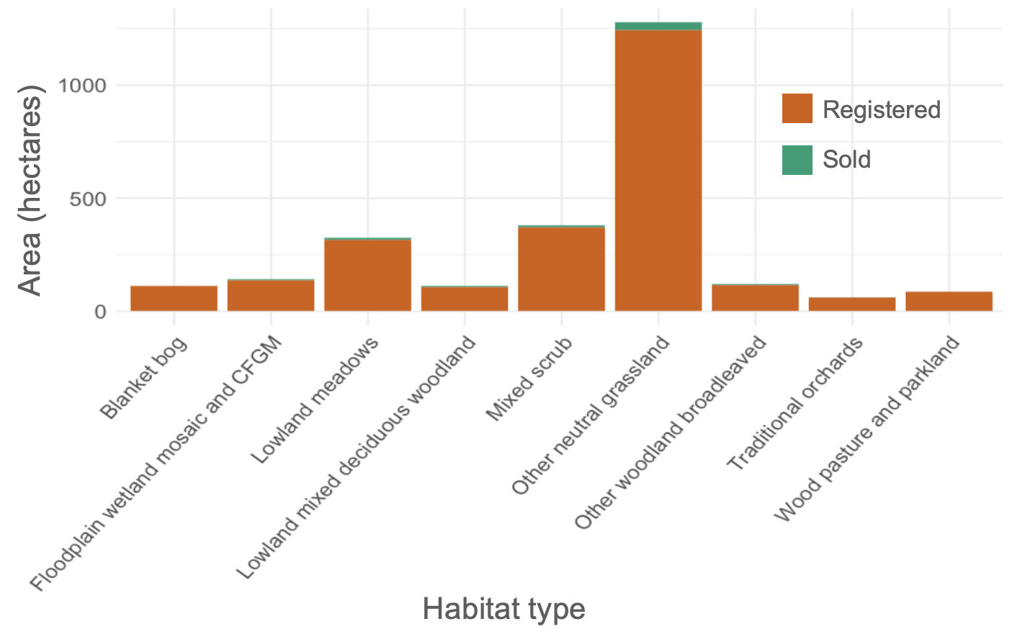
Institutional fit – England example
Duffus et al. (2025), BioRXiv

Slide 31
Other considerations in Finnish system
Institutional capacity. Big role for regulators in 2-stage project approval and accreditation process
  Ensure sufficient capacity
  Capacity shortages widespread in offset markets; often seen as a public cost to be minimised rather than asset to protect scheme integrity and value
  Finland better than other countries who allow details of offset plans to be delivered in post-approval stage (eg England, Australia EPBC (Evans 2023)).
  Other countries have outsourced governance – eg England’s ‘Responsible bodies’ model

Slide 32
Takeaways
Finland’s system presents as high capacity, carefully thought through
World leading transparency, permanence, legitimacy via co-creation & robust ex-ante projections
Biggest weakness is lack of ongoing monitoring or validation of ex-ante biodiversity projections. No obvious system for early warning of compliance problems seen in most other offset markets
Other major risk is lack of demand without credible demand drivers

