Slide 1
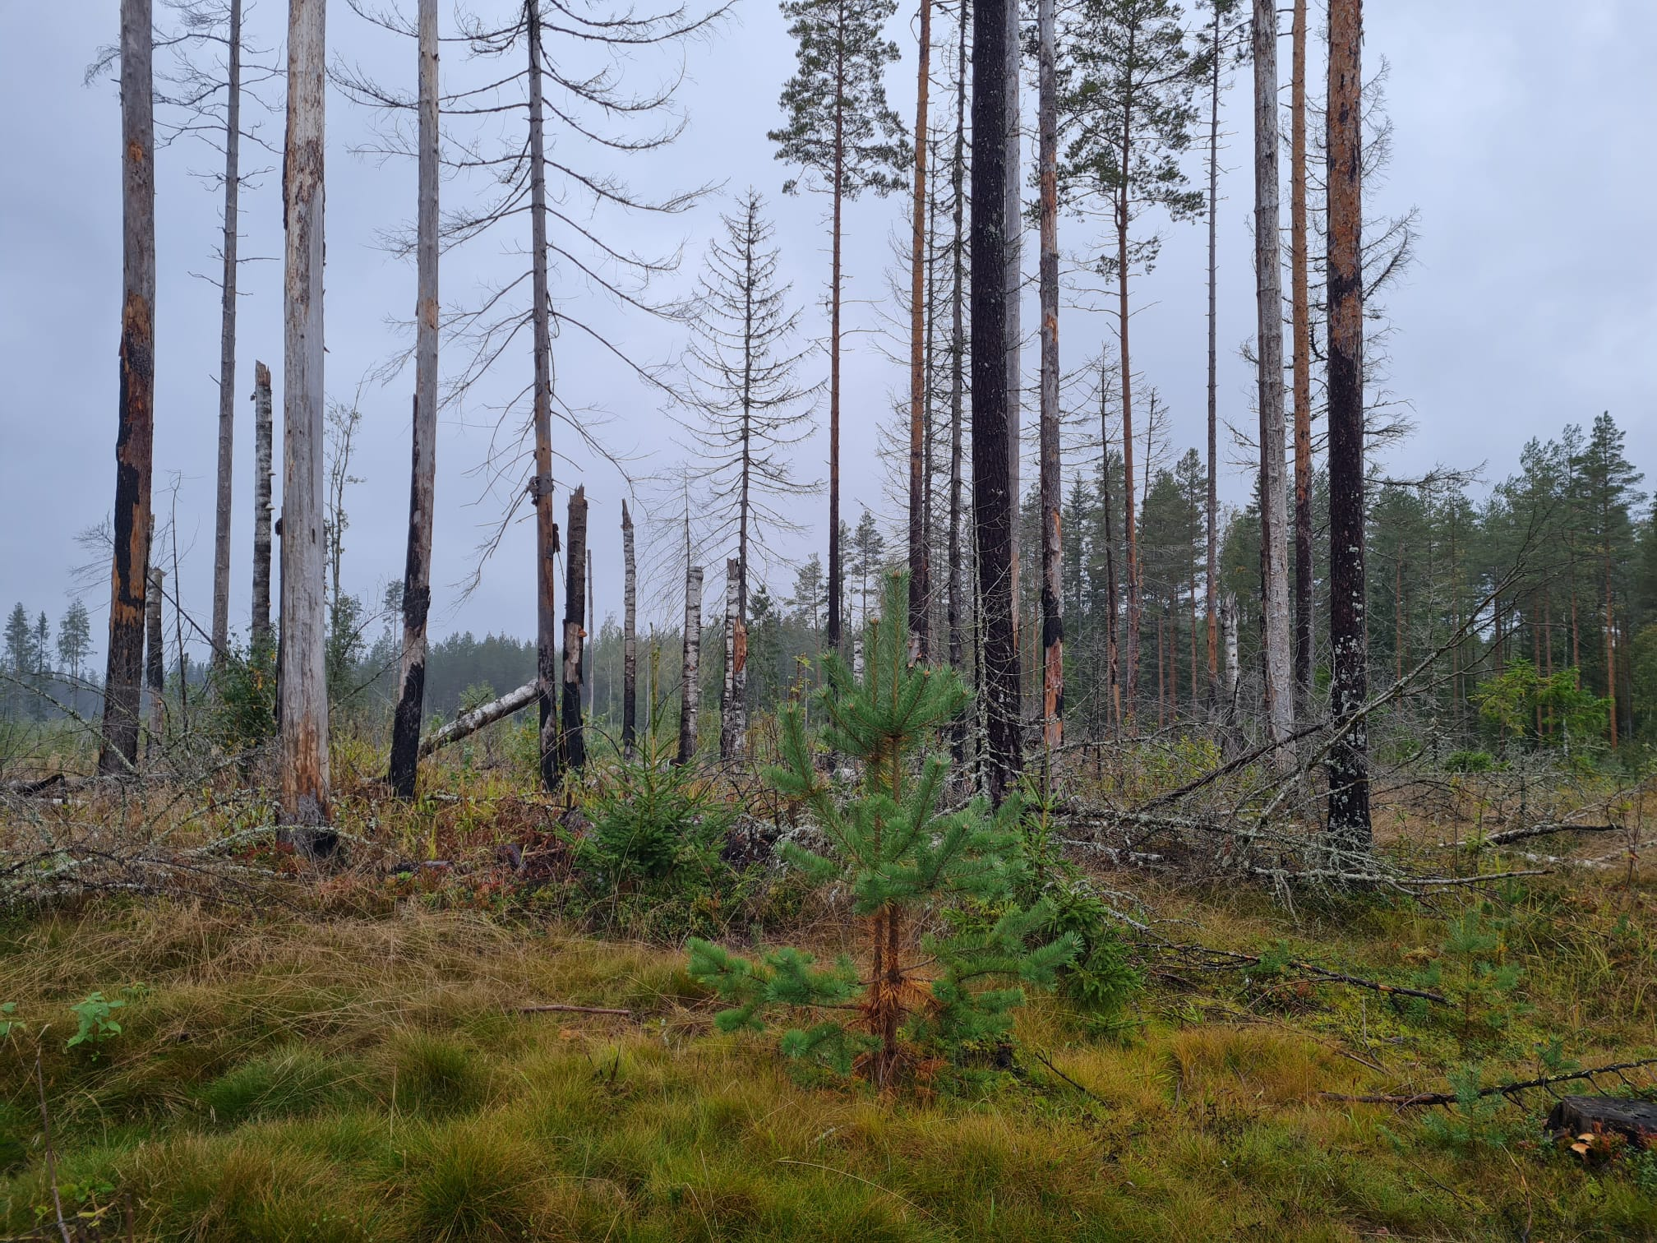

Societal aspects of Nature Credit Markets
Paula Horne
Pellervo Economic Research PTT
Evaluation of the Finnish Biodiversity Offsetting System and Its Applicability in Nature Credit Markets

Slide 2
Focus on the NIPF owners
Supply side: about half of the forest and forestry land is owned by non-industrial private forest owners (average size 48 ha / forestry land, >5 ha)
Institutional and public forest ownership – already engaged in Nature Credit markets

Slide 3
Management options
Conservation
Based on securing existing ecological value and preventing its immediate deterioration; outcomes are immediate
Additionality is open to differing interpretations
Passive
May be permanent or fixed-termed
Costs consist of opportunity costs; not well suited to results-based financing
Ecological restoration
Improves degraded ecosystems
Additionality can be demonstrated clearly; there may be a time lag before outcomes are realized
Active in nature; often implemented as a one-off intervention, although follow-up measures may be required
Generally permanent
Costs consist largely of direct costs, are concentrated in the initial phase, well suited to results-based approaches
Nature management
Embedded in agricultural and forestry practices; improves ecological condition; realization of outcomes vary
Additionality can be demonstrated
Includes both active and passive measures
Generally fixed-termed
Costs consist of direct costs and/or opportunity costs; results-based approaches are applicable

Slide 4
Highest interest in measures which are compatible with active farming or forest management = nature management
Landowners’ views of different measures for safeguarding biodiversity
Source: Korhonen ym. 2024 MTK & SLC bd tiekartta
Hectares of sites with nature values applicable

Slide 5
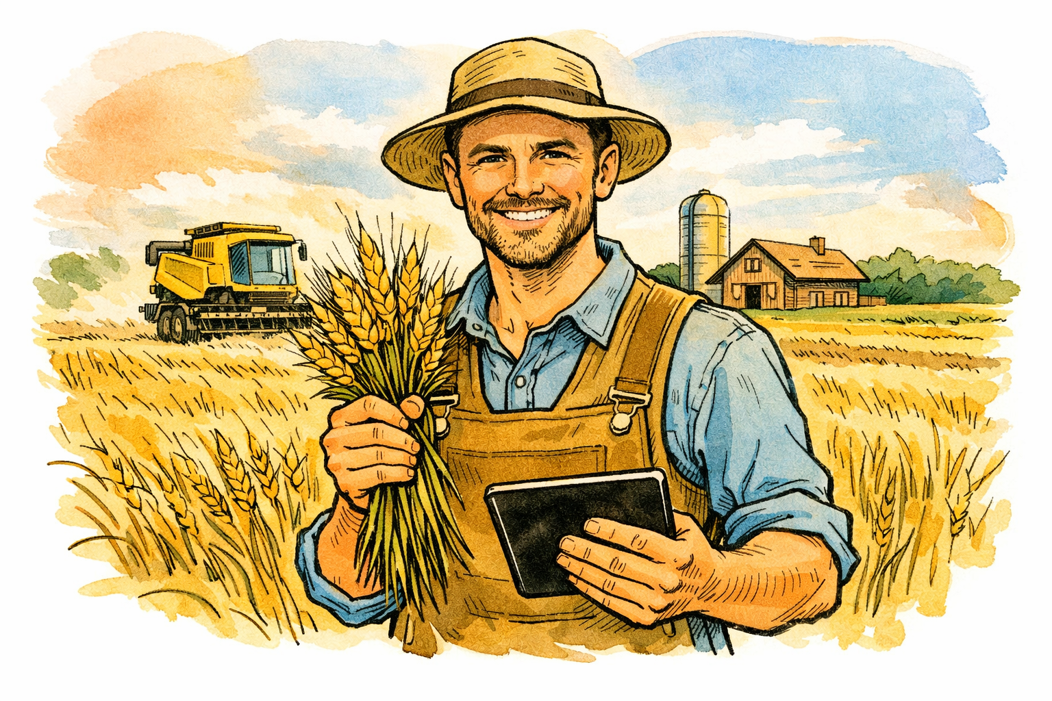

Agricultural producers: - full-time agricultural producers - crop farming - organic producers
Landowners’ views of different measures for safeguarding biodiversity
The most prominent background characteristic of those interested is a higher level of education.
Forest owners: - employees, forestry entrepreneurs, or other entrepreneurs - larger forest holdings
Source: Korhonen ym. 2024 MTK & SLC bd tiekartta

Slide 6
Landowners’ views on nature credit markets I
The level of compensation, the degree of commitment required, and the flexibility of the scheme all influence willingness to participate.
Participation in biodiversity credit markets requires substantial expertise and entails multiple risks.
There are significant capability gaps in the identification of suitable sites, the planning of interventions, valuation, contracting, pricing, marketing, and risk management.
The market is still underdeveloped and is characterized by a marked lack of reference points: there are no statistics, few peer examples, and only limited experience-based professional expertise.

Slide 7
Landowners’ views on nature credit markets II
Landowner participation in the market:
Direct transaction with the buyer: This model requires substantial expertise and effort on the part of the landowner, although platforms or other intermediary organisations may provide support in site delineation, marketing, and contract negotiation.
Habitat banking: In this model, the landowner sells to an intermediary, which then transacts with the end user of the biodiversity values, that is, the buyer. This arrangement reduces the producer’s share of the value and limits the producer’s control over the buyer relationship.
Monitoring, reporting, and verification (MRV) systems must be both acceptable to participants and feasible to implement.
For landowners, it is important that the registry safeguards privacy and does not disclose publicly accessible personal data or precise site location data.

Slide 8
Ecological compensation: Active, well-resourced landowners who are able to cover upfront costs (offset plan, initial measures), and for whom legal certainty and permanent protected-area status are important. Particularly well suited to large or high-quality sites, and to owners who want to act proactively and offer offset units for project needs. | Nature value trading: Market-oriented landowners who value flexibility, secured income in advance, and/or the possibility of ongoing management payments. Suitable for owners who want to negotiate the price and are willing to accept the uncertainty associated with market fluctuations.
State-led programmes (e.g. METSO): Risk-averse owners who value administrative clarity, transparent criteria, and a predictable level of compensation. Programmes are particularly suitable for those who do not want to negotiate prices in the market or bear the risk of insufficient demand. | Self-initiated, voluntary protection and nature management without compensation: Value-driven owners Suitable for those for whom the economic return from the site is of little importance, or for whom autonomy is important.

Slide 9
Units of Nature Credits
The marketable commodity consists of the improvement in ecological condition generated by the intervention relative to the assumed baseline trajectory.
The units quantify the incremental ecological gains produced by the interventions, including gains in species richness, habitat condition, and area.
A robust unit should be fit for purpose, additional, measurable, and legally unambiguous; moreover, the same unit must not be marketed more than once.
The criteria applicable to units used for ecological compensation are more extensive. (e.g. like-to-like)
The hectares of sites with nature values (later: the nature value hectare) provides a commensurate metric, but was perceived as overly theoretical, administratively burdensome, and costly.. However, it is necessary in ecological compensation.

Slide 10
Thank you!
More information:
Paula.horne@ptt.fi
Jani.laturi@ptt.fi

