Slide 1







How to define biodiversity offset gains based on science
Prof. Heini Kujala
Finnish Museum of Natural History
Faculty of Biological and Environmental Sciences
University of Helsinki

Slide 2
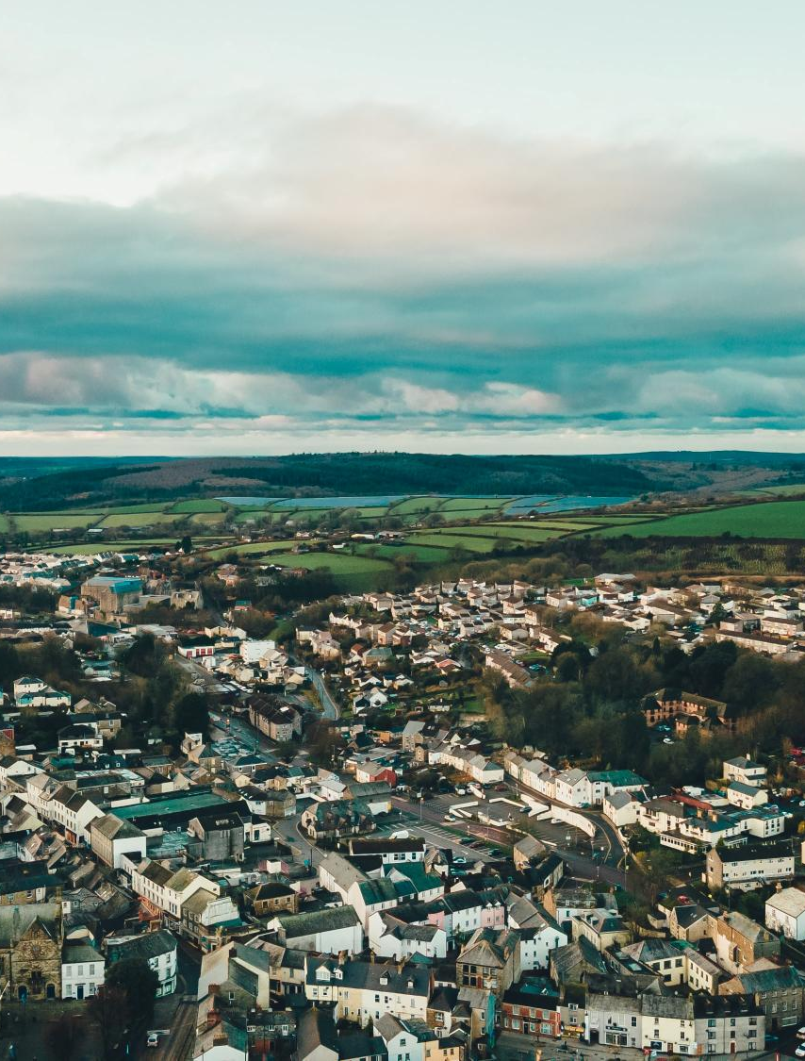
Biodiversity offsetting
(ecological compensation)
Biodiversity losses caused by humans are compensated by producing equivalent amount and type of biodiversity gains elsewhere
ANDREY ZAYCHUK / UNSPLASH
Notes:
Gains produced through e.g. protection, restoration etc.
Losses and gains need to match, not area

Slide 3

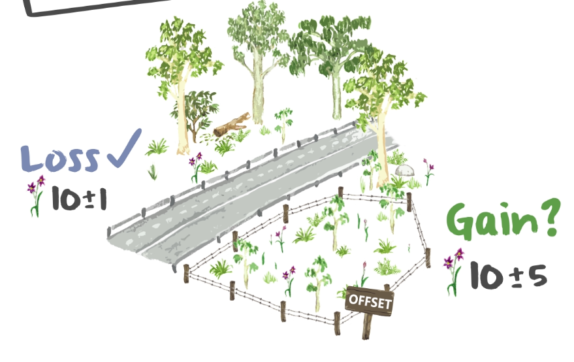

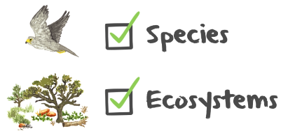
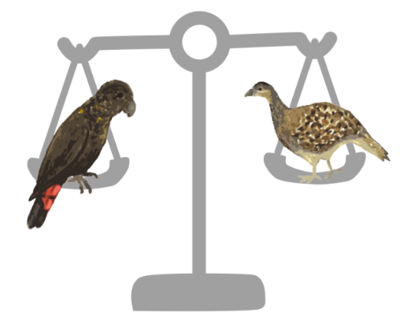
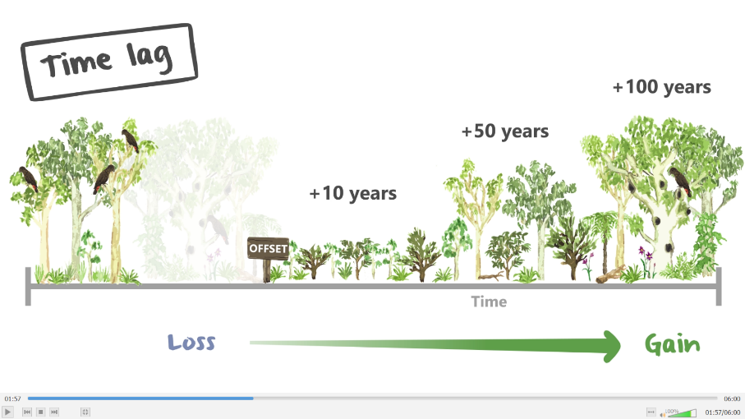
IMEC
Impact Mitigation and
Ecological Compensation
Graphics: Zoë Stone

Slide 4
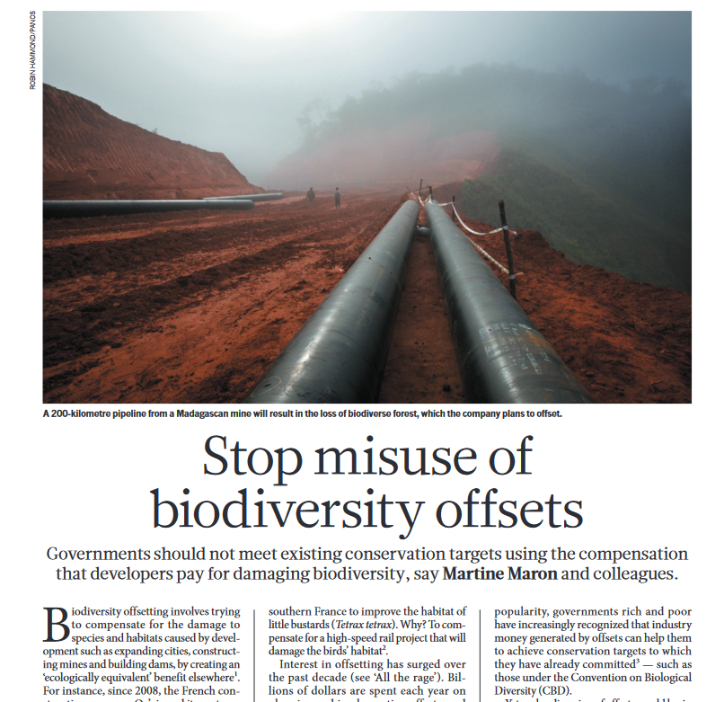
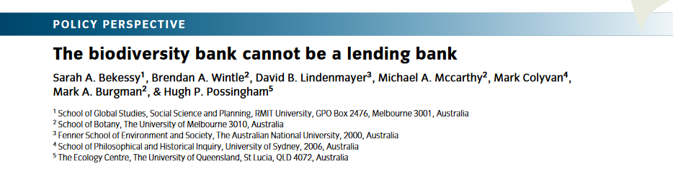
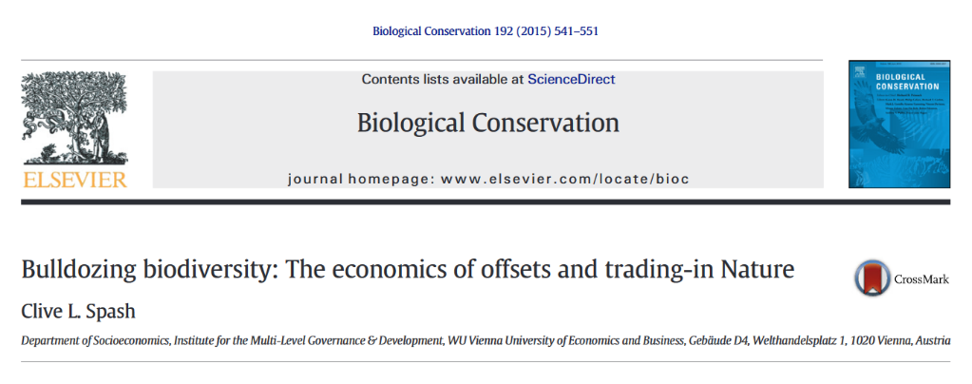
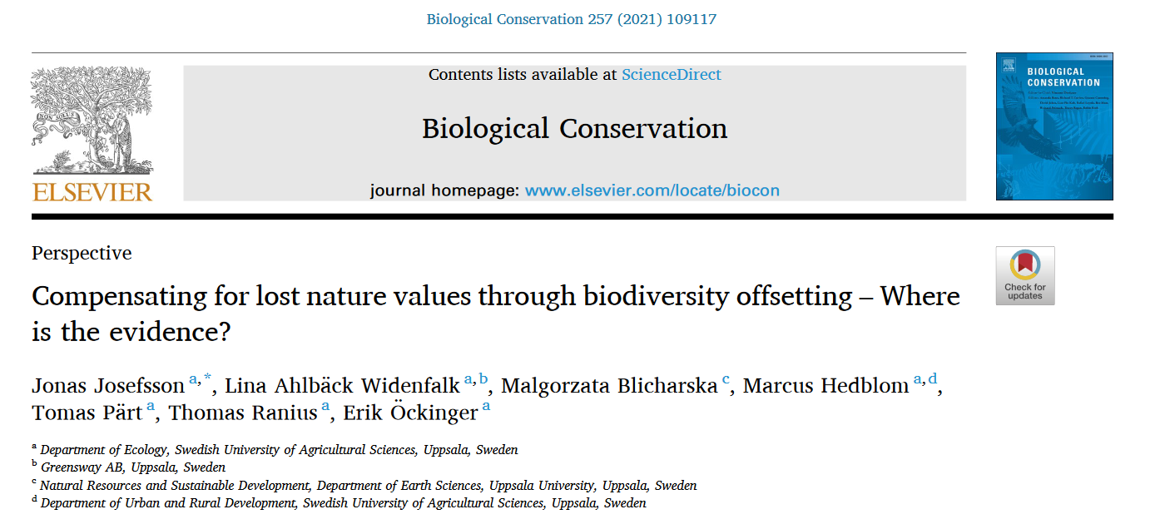
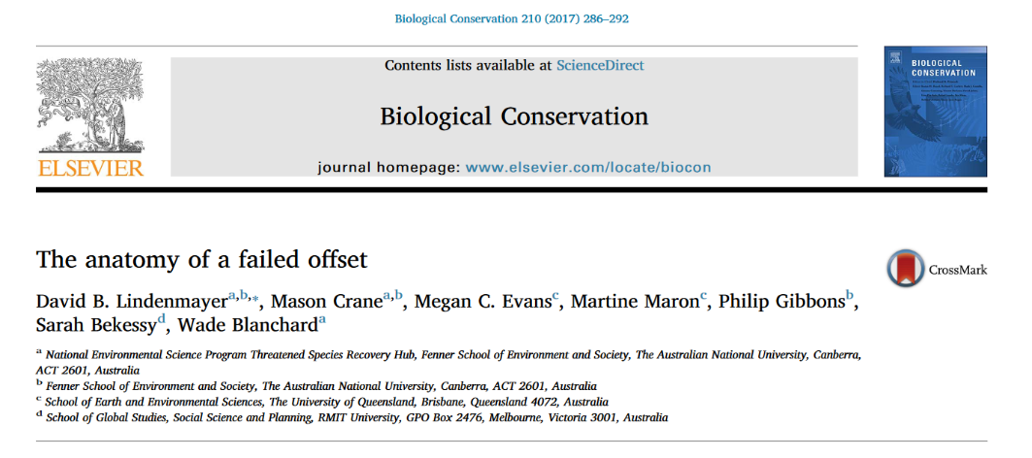

Slide 5
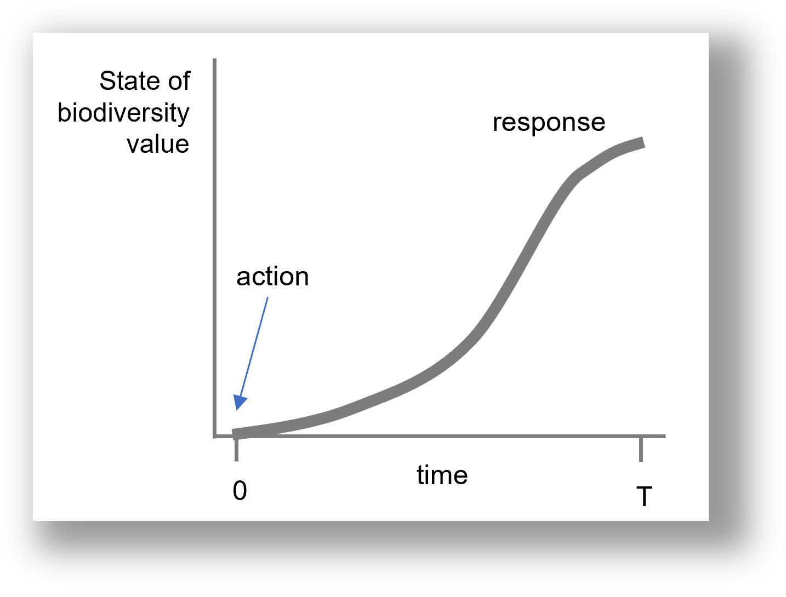
Developing an ecologically robust offset calculation
Common metric
Biodiversity measured in habitat hectares (luonnonarvohehtaari)
Habitat hectare = Area x Ecological condition
Realistic gains that include time-lags and uncertainty
Habitat types and species response differently to actions (magnitude, time, certainty)
Change in ecological condition
Moilanen & Lehtinen (2025) Simple analysis of biodiversity response functions and multipliers for biodiversity offsetting and other applications
https://doi.org/10.1016/j.envsoft.2025.106322
Notes:
→ how much does an action improve the ecological condition?

Slide 6
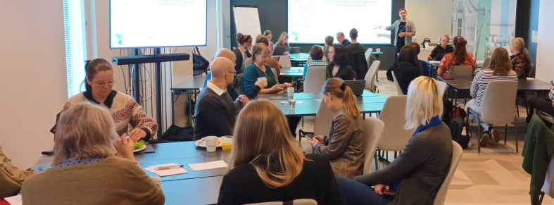

Guidelines for offsetting habitat types
Expert elicitation 2022-24
111 experts, 22 workshops
Trading rules – what can be traded with what?
Criteria for ecological condition – how is condition measured?
Biodiversity responses for over
200 habitat type x action –combinations
– how do actions improve habitats?
Assessment forms & guidelines of using and creating (additional) responses

Slide 7
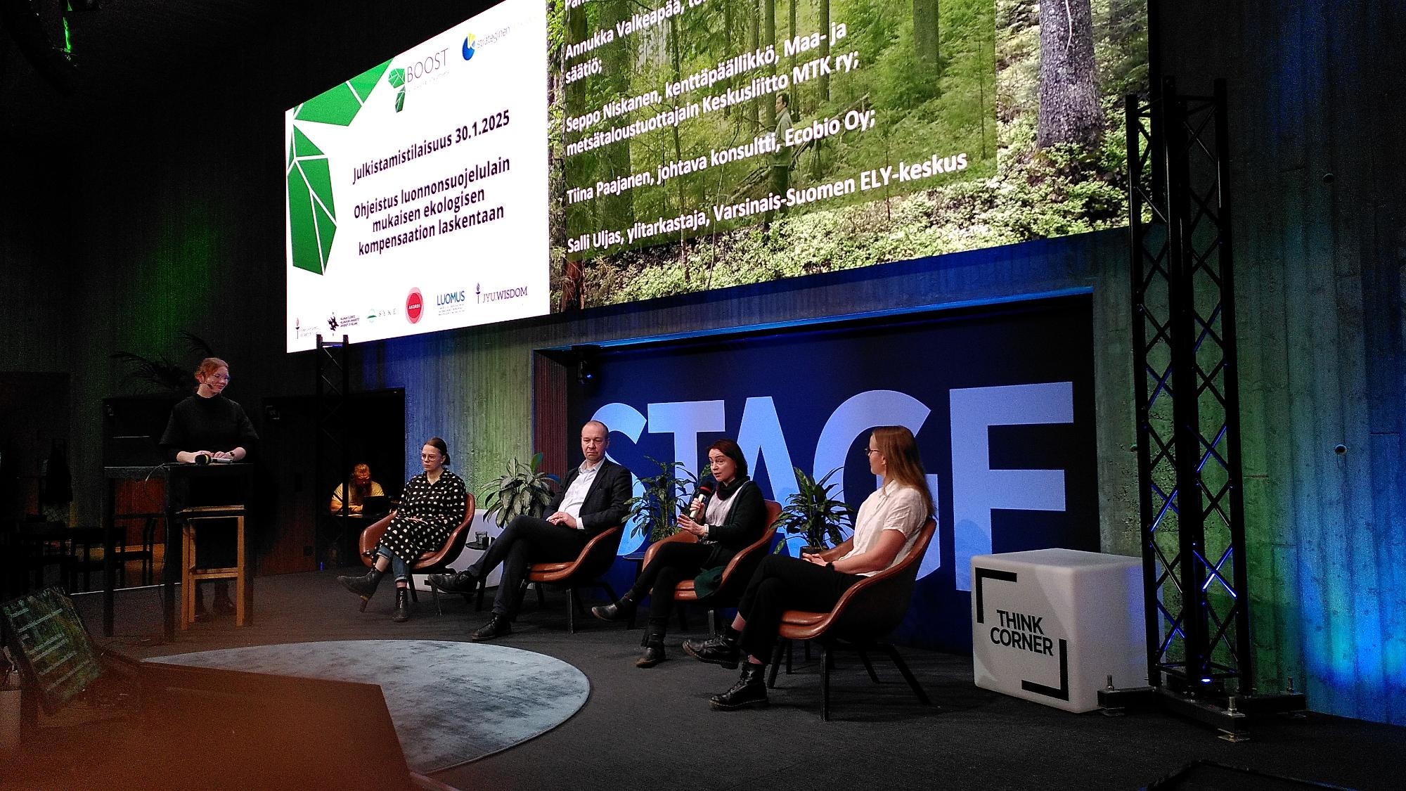
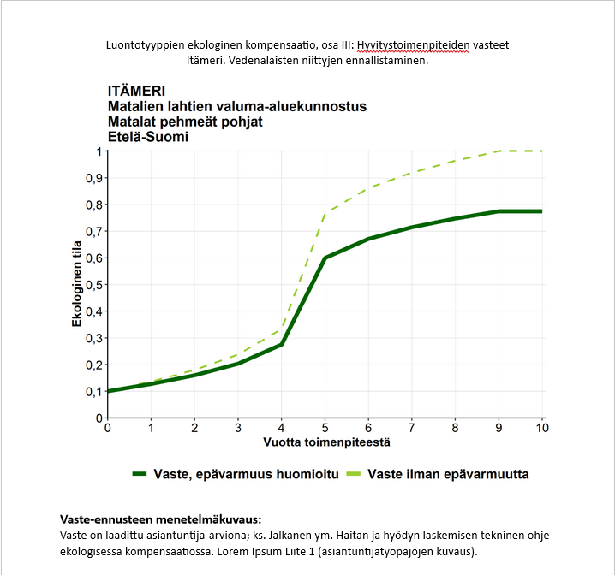
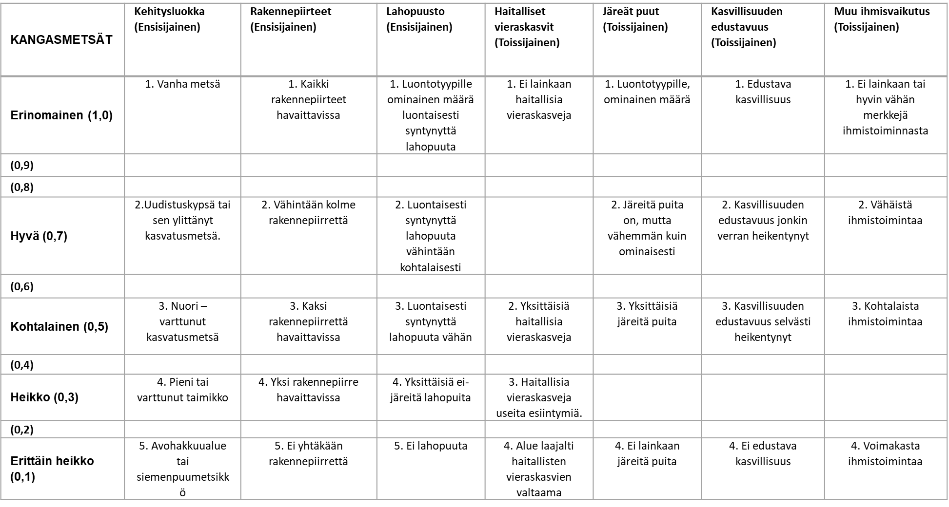
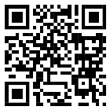
Scientific article: Jalkanen et al. (in review)
https://www.biorxiv.org/content/10.64898/2026.01.26.701764v1.abstract

Slide 8
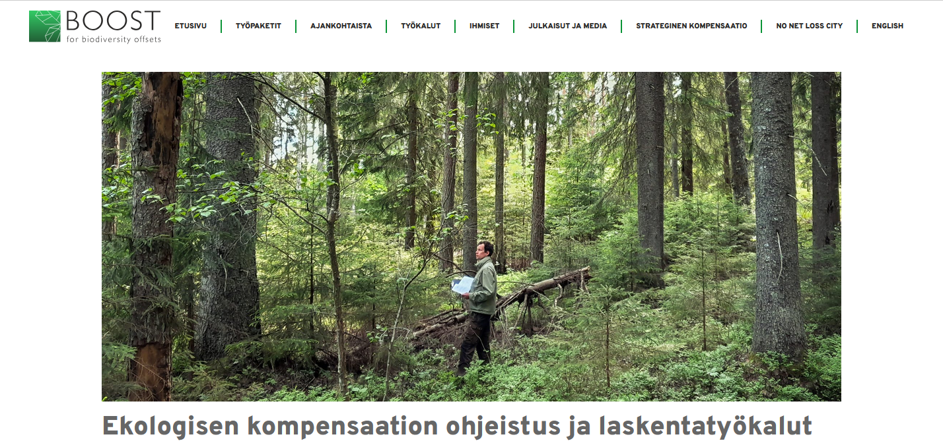
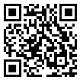
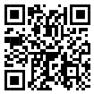
Available tools and resources (in Finnish)
condition assessment matrices
field guidelines
habitat hectare and offset calculators
instructions for biodiversity offset calculations
Online courses (in Finnish)
Introduction to biodiversity offsetting
Offset calculation

Slide 9
Rapid uptake
Municipalities
Helsinki: offsetting model 2026
Jyväskylä: biodiversity offset pilot 2023-25
Lahti: city-owned habitat bank (ongoing)
Joensuu: offsetting of a zoning plan (starting)
Vantaa: 1st official biodiversity offset
Other applications using habitat hectares
S-group, Lähitapiola, Finsilva: nature market pilot (2026)
habitat hectares used in EIA (YVA) assessments
ANDREY ZAYCHUK / UNSPLASH
Notes:
Losses and gains need to match, not area

Slide 10
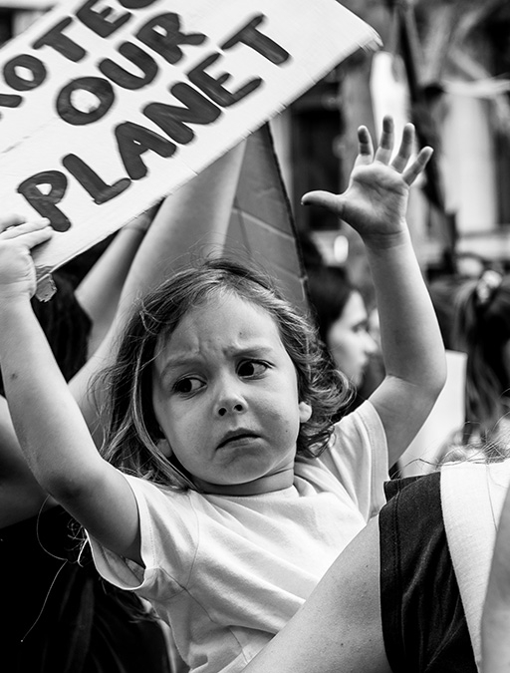
Some of the remaining open questions
Monitoring of offset sites to confirm expected gains and to inform the updating of calculation system
Could landowners sell additional gains that develop after 30 years?
          incentive for producers to participate
Moilanen, Jalkanen, Halme, Nieminen, Kotiaho & Kujala (2024)
Monitoring in biodiversity offsetting
https://doi.org/10.1016/j.gecco.2024.e03039

Slide 11
Kiitos

