Slide 1
Generation and Use of Nature Credits in Finland
18.3.2026
Leila Suvantola, Senior Ministerial Adviser, Legal Affairs
Ministery of the Environment, Aquatic and Natural Environment, Biodiversity and Nature Values Finance

Slide 2
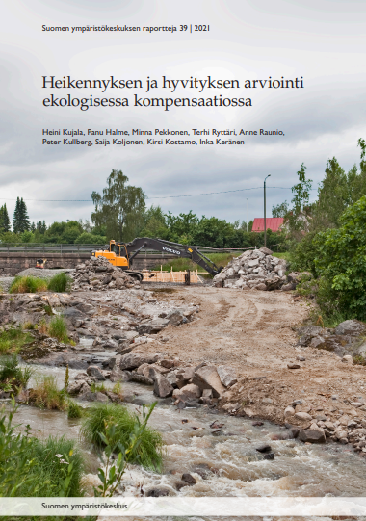
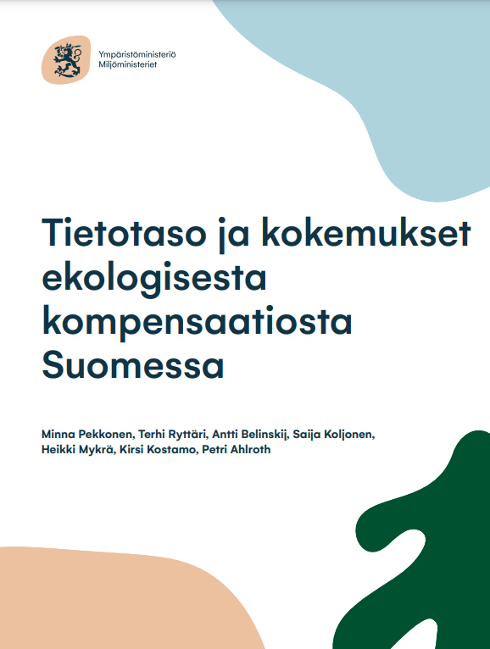
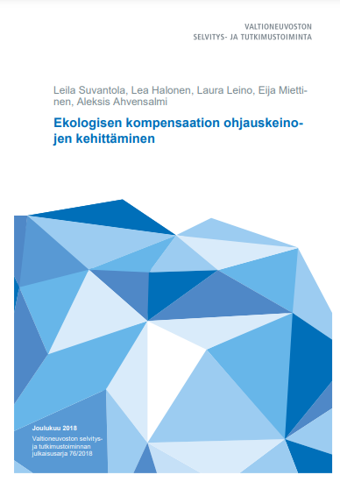
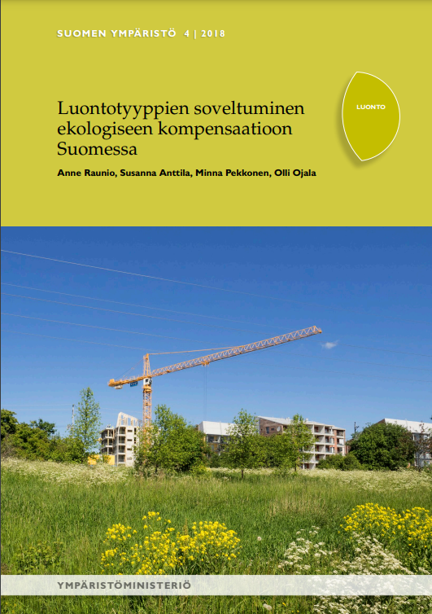
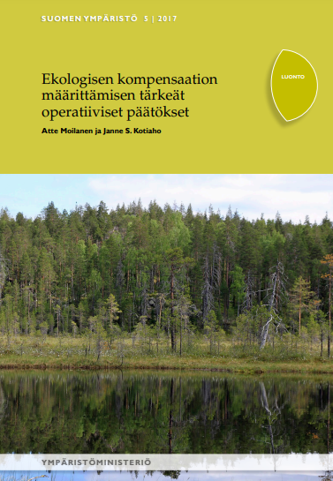
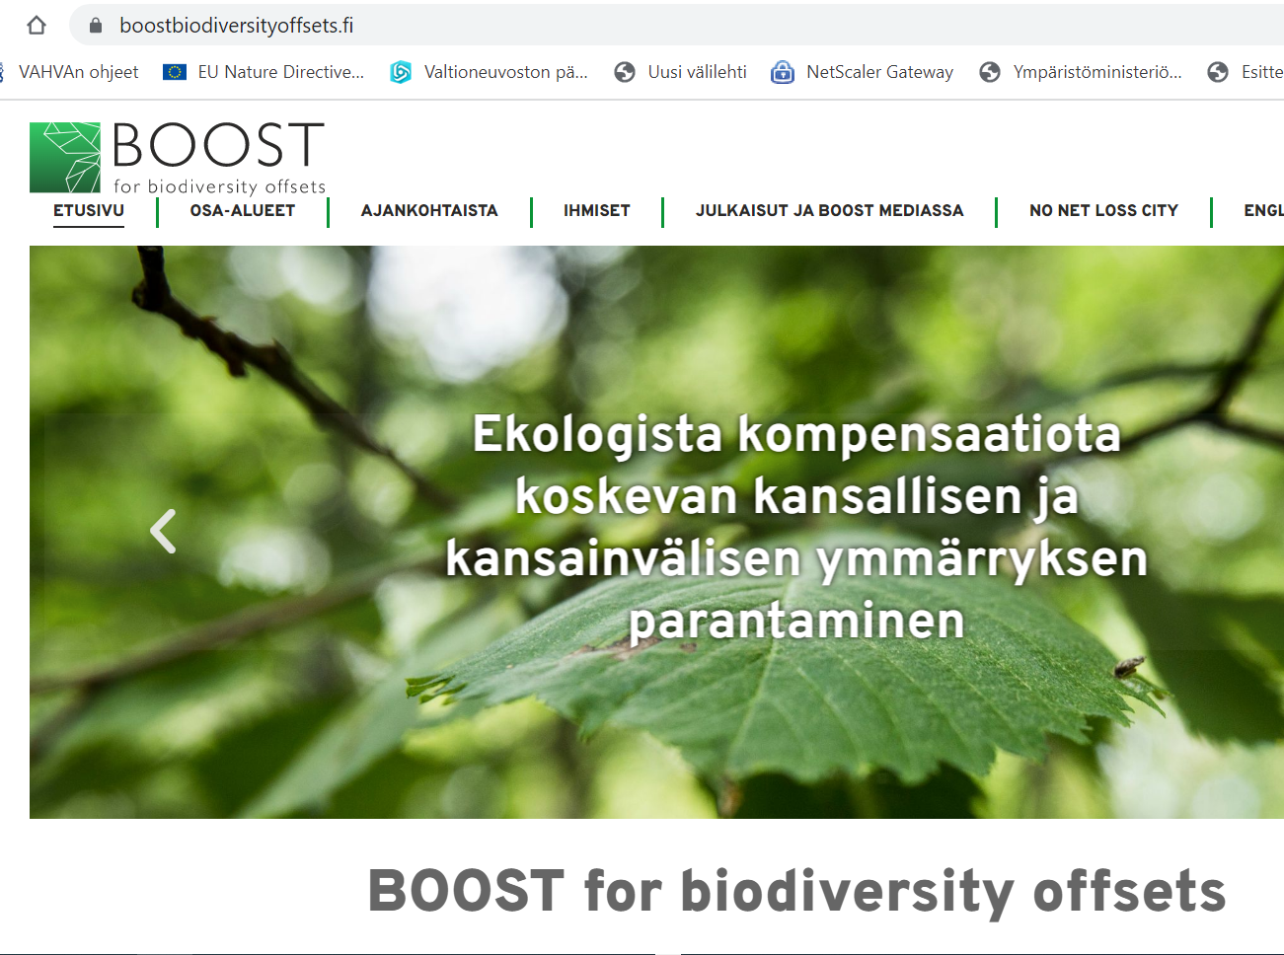
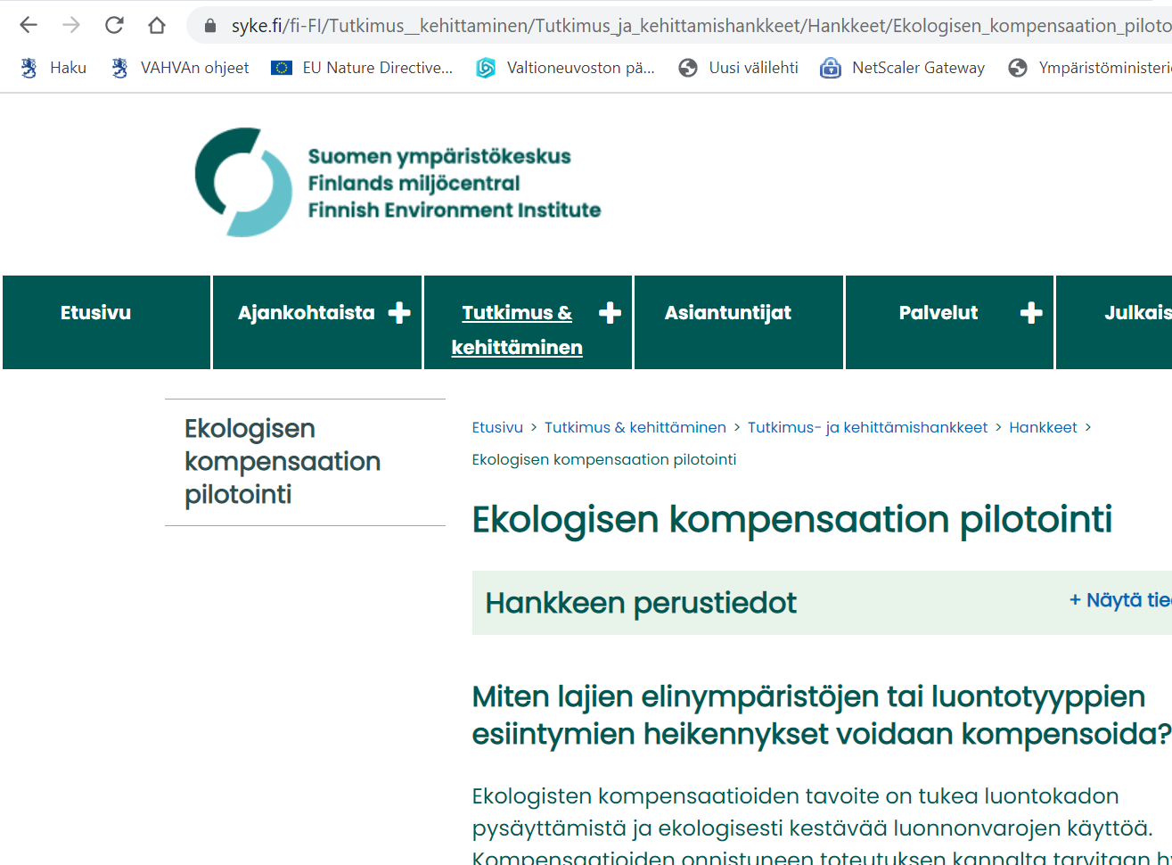
Revision of the Nature Conservation Legislation 2023
Chapter 11 in the Nature Conservation Act (9/2023), in force 1.6.2023 (certification rules, offsetting rules) + Decree of the Ministry of the Environment on Voluntary Ecological Compensation (933/2023), in force 15.9.2023 (the metrics)
Offsetting consists of
certified generation of natural values (nature value hectares = national nature credit unit)
rules for offsetting degradation of natural values with pregenerated certified nature value hectares
Drafting of legislation was supported by an expert group of ecologists
(what, where and when criteria to achieve no net loss)
Several preceeding studies
Ongoing research

Slide 3
Aim to Address the Identified Challenges
Identified challenges | How addressed
Offsetting activities are not implemented | Fundamental offsetting measures / conservation has to preceed deterioration Separation of the roles of generator of nature values and proponent of actitive causing degradation
Offsetting is not permanent | Permanent prohibition on destruction and deterioration of the nature values of the offset site once used as offset If derogation, obligation to offset the degradation including nature values to be generated
Time lag between degradation and offset | Fundamental offsetting measures / conservation to preceed deterioration Equivalence on achieved increase in nature values + average cumulative annual benefits over a period of 30 years
Genuine additionality | Criteria of offset (not obligatory under legislation or other obligation), certification by an authority, accounting rules
License to trash and green wash concerns | Certification by an authority, open access register
Low willingness of land owners to invest in production of nature values | Certification by an authority, open access register

Slide 4
Additionality
Only such measures generate nature values that are not required by legislation, agreement or other e.g. certification
Offset measures = restoration towards the natural state or a desired state in terms of biodiversity / increase of the surface area of the habitat or in the ecological quality of the habitat
Conservation offset = maintains or improves the natural state or the desired state in terms of biodiversity by preventing activity causing the deterioration of the natural state and produces a better ecological outcome than offset measures
only passive restoration response accepted currently (until a scientifically sound assessment method for avoided loss for each potential habitat type is presented)

Slide 5
Metrics
Nature value hectare = quantity (area) x quality (status of the nature value = habitat / habitat of species)
Status of the nature value = ten-step scale from 0 (= a site that has lost its natural state) to 1 (= a site that is in its natural state or a comparable state) based on the assessment of the indicators for each habitat type group
Listed in the Ministerial Decree on Ecological Compensation Annex 1; Detailed guidance by the SYKE financed by MoE and the BOOST research group financed by the Finnish Academy
Increase in nature value hectares = Quantity (area) x quality (increase of the status due to restoration / passive restoration 0-1) already accrued + average cumulative gain in the next 30 years
Response to offset measures = "best available scientific information" of the maximum improvement / duration / (un)certainty of tested restoration measures for all habitats (available https://boostbiodiversityoffsets.fi/tyokalut/ in Finnish)
Response to conservation = Passive restoration response accepted currently (until a scientifically sound assessment method for avoided loss for each potential habitat type is presented)

Slide 6
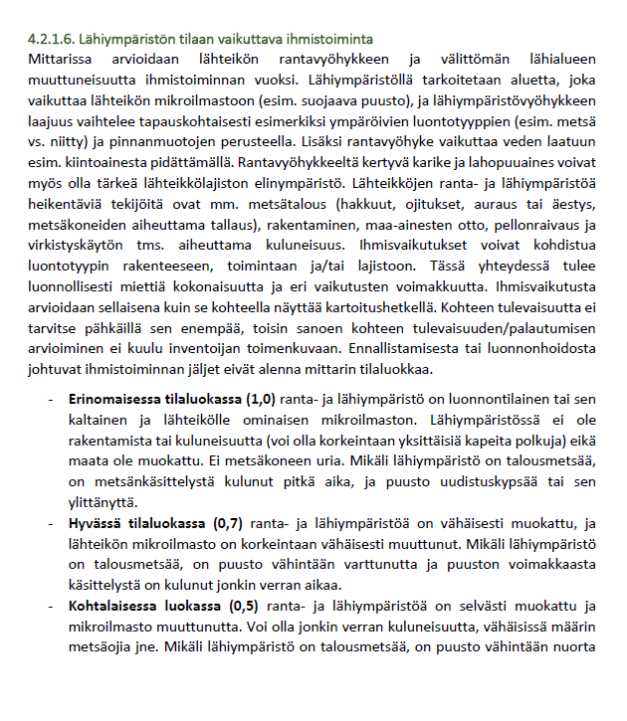
Composition of the set of indicators (Ahola 2025)
Baltic Sea
Baltic Sea coast
Freshwater
Peatland
Forest
Rocks and scree
Grassland
Fell
Habitat types are divided into 8 main groups (Red List of Habitat Types 2018)
Each main group has 2 to 5 subgroups of habitat types
Each subgroup has an indicator set, consists of 2–8 indicators
For each meter, a condition class will be assessed = value 0,1…1,0
Short verbal description given for 2 to 5 condition classes
Additional instructions given in an interpretation guide
Indicator set 1 (Rock outcrops)
Indicator set 2 (Scree)
Indicator set 3 (Rock faces)
Indicator 1 | Indicator 2 | Indicator 3 | Indicator 4 | Indicator 5
Edustava kasvillisuus. Luontotyypille, maantieteelliselle alueelle, paikallisolosuhteille ja | … | … | … | …
Kasvillisuuden edustavuus jonkin verran heikentynyt. | … |  | … | …
 | … |  | … | …
Ei edustava kasvillisuus. Lajisto hyvin muuttunutta | … | … | … | …
Interpretation guide

Slide 7
Example: Forest indicators set 1 (heath forests)
 | Age class | Stand structural characteristics | Amount and quality of dead wood | Vegetation representativeness | Number of large trees | Invasive alien species | Other human influence
1.0 (excellent) | Old-growth forest, or natural young succession stage | All naturally occurring characteristics of the tree stand are present | Natural amount of dead wood and all natural characteristics of dead wood are present | Representative vegetation. Species composition and structure are natural and representative to the region and succession stage | Natural amount of large trees, considering the region and succession stage | No invasive alien plant species | No or very weak signs of human activity (e.g. single trails)
0.9
0.8
0.7 (good) | Harvest age reached | At least three naturally occurring characteristics | At least moderate amount of natural dead wood, and two characteristics | Slightly decreased represen-tativeness. The natural species composition is present but not totally natural | Somewhat less large trees than natural |  | Minor human activity (e.g. minor ditches)
0.6
0.5 (moderate) | Young or mid-aged managed fores | Two characteristics | Small amount of natural / moderate amount of human-made dead wood | Clearly decreased represen-tativeness. Clear changes in species composition and structure, but some typical species present | Individual large trees | Individual invasive alien plant species | Moderate human activity (e.g. erosion of forest vegetation, trash, ditches)
0.4
0.3 (poor) | Sapling stage | One characteristic | Only individual dead trees, no natural characteristics |  |  | Invasive alien species occur commonly
0.2
0.1 (very poor) | Clearcut | No natural characteristics, or a monoculture of alien tree species | No dead wood | Not at all representative. Species composition severely altered, almost no typical species | No large trees | Area largely occupied by invasive species | Heavy human activity (e.g. largely eroded vegetation, heavy ditching or plowing)
0.0 | (not a habitat type)

Slide 8
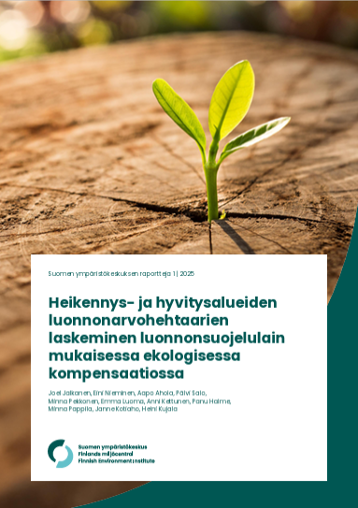
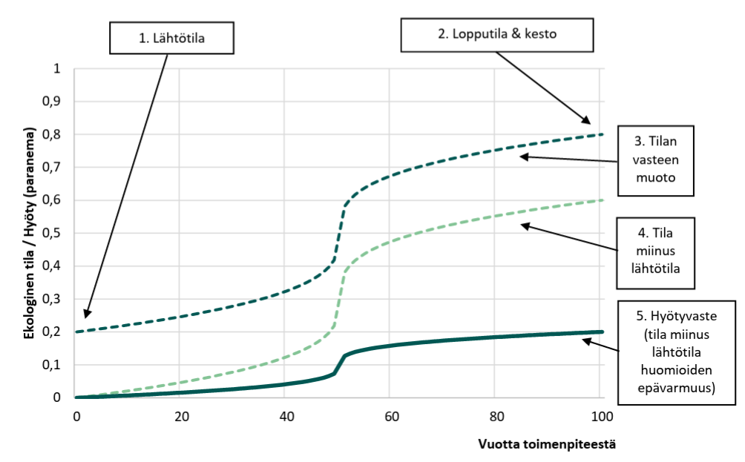
http://hdl.handle.net/10138/591139
Initial status
Final status
Shape of response
Ecological status / gain (increase)
Status - initial status
Gain (status - initial status – uncertainty)
Years from the restoration (offset) measures

Slide 9
Certification and Register
State environment authority approves the plan to generate nature values
After restoration activities have been carried out the environment authority certifies the amount and type of generated nature value hectares
Information on the generated nature value hectares is registered in the offset register (book keeping to avoid double counting)

Slide 10
Use of Generated Nature Value Hectares
Voluntary offsetting of degradation of natural values
Assessment of the loss of nature values based on the same criteria
Equivalence of quality, quantity and spatiality
Decision by the state environment authority on the equivalence of the offset
Permanent prohibition of the destruction and deterioration of the nature values of the offset site (definition of the boundaries of the offset site)
Prohibition registered in the land register
Information in the open access offset register
Other nature positive activities
Public Consultation of the draft Government Proposal 12/2025-1/2026
-> Preparation of minor revision of the provisions of the Nature Conservation Act to enable:
A) trading and retirement of nature value hectares
B) permanent protection of the generated nature values
on the request of the rights holder
Finalisation and to be proposed to the Parliament

Slide 11
Assessment criteria; scale 0-1
Landowner (generator): plan for generation of nature value hectares (hhs): assessment of initial status, planned restoration activities, projected gains
Best available scientific knowledge on restoration response and time
Environmental Authority (EA): Statement verifying the initial state, recommendations on planned activities
Generator: restoration activities (fundamental measures)
Project proponent: assessment of degradation
EA: statement on the type and amount of nature value hectares (hhs) to be generated (entry to register)
Used as offsets
Proponent: agreement with the generator / owner of hhs + proposal to the EA
Used as nature positive activity
Trading
(register of ownership)
EA: Decision on the equivalence of quality, quantity and spatiality​
EA: Decision on permanent prohibition of degradation of the site where hhs are generated; registered as used

Slide 12
Thank you Additional information: https://ym.fi/en/ecological-compensation
Leila.suvantola@gov.fi

